Slide 1
IST718 Advanced Information Analytics MapReduce, Hadoop and Yarn
Willard Williamson
Adjunct Professor
iSchool, Syracuse University
linkedin.com/in/ncc-1701-d

Slide 2
Resources
If you are totally new to git, you can learn about git using free training materials available on LinkedIn.
As a Syracuse University Student, you get a free subscription to the lynda.com learning web site which is part of LinkedIn.
Log in at https://lynda.syr.edu using your SU login credentials.
If you have a LinkedIn account, you should now have access to Lynda training tutorials through LinkedIn Learning.
LinkedIn Learning is available through your LinkedIn home page.
The next few slides show how to access Lynda learning content for free using LinkedIn Learning.

Slide 3
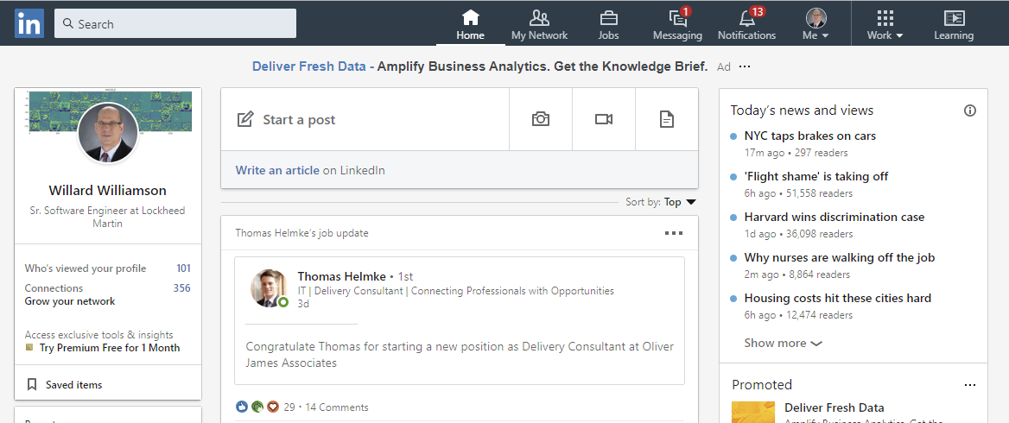
Resources
Log into LinkedIn and select Learning (See the red outline to the right)

Slide 4
Resources
On the following slide, if you successfully logged into Lynda.com using your Syracuse University credentials, you should see the orange Syracuse University symbol on the top right of your screen.

Slide 5
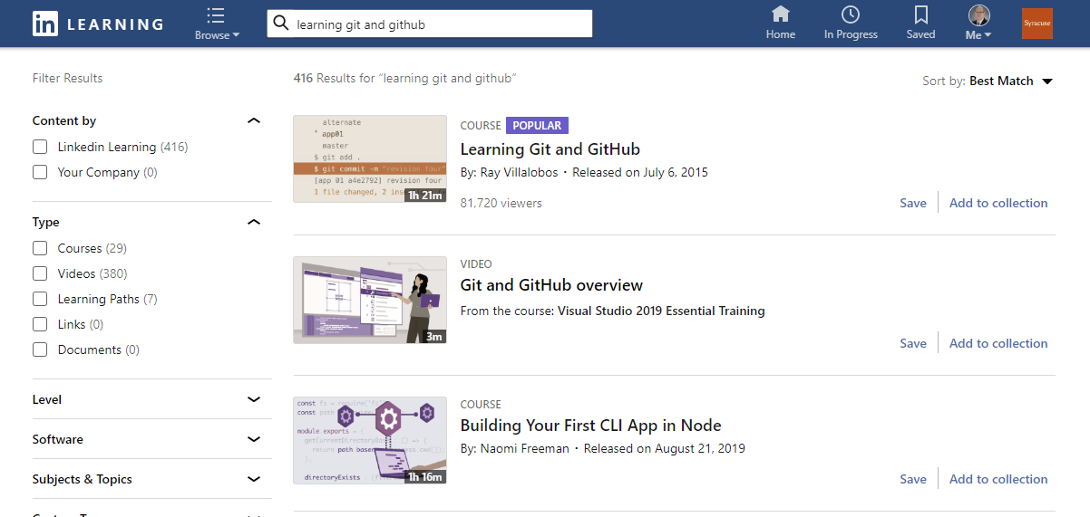
Resources: Github
You should see the orange Syracuse icon in the top right of your screen

Slide 6
Resources: Github
It is recomme ded to go through chapter 1 of the Learning git and github tutorial.
You do not need advanced git skills, you only need to understand the basics.

Slide 7
How to Clone and Submit IST-718 Homework

Slide 8
Download and install github desktop
https://help.github.com/en/desktop/getting-started-with-github-desktop/installing-github-desktop

Slide 9
Configure github desktop
https://help.github.com/en/desktop/getting-started-with-github-desktop/configuring-git-for-github-desktop

Slide 10
Configure github desktop authentication
https://help.github.com/en/desktop/getting-started-with-github-desktop/authenticating-to-github

Slide 11
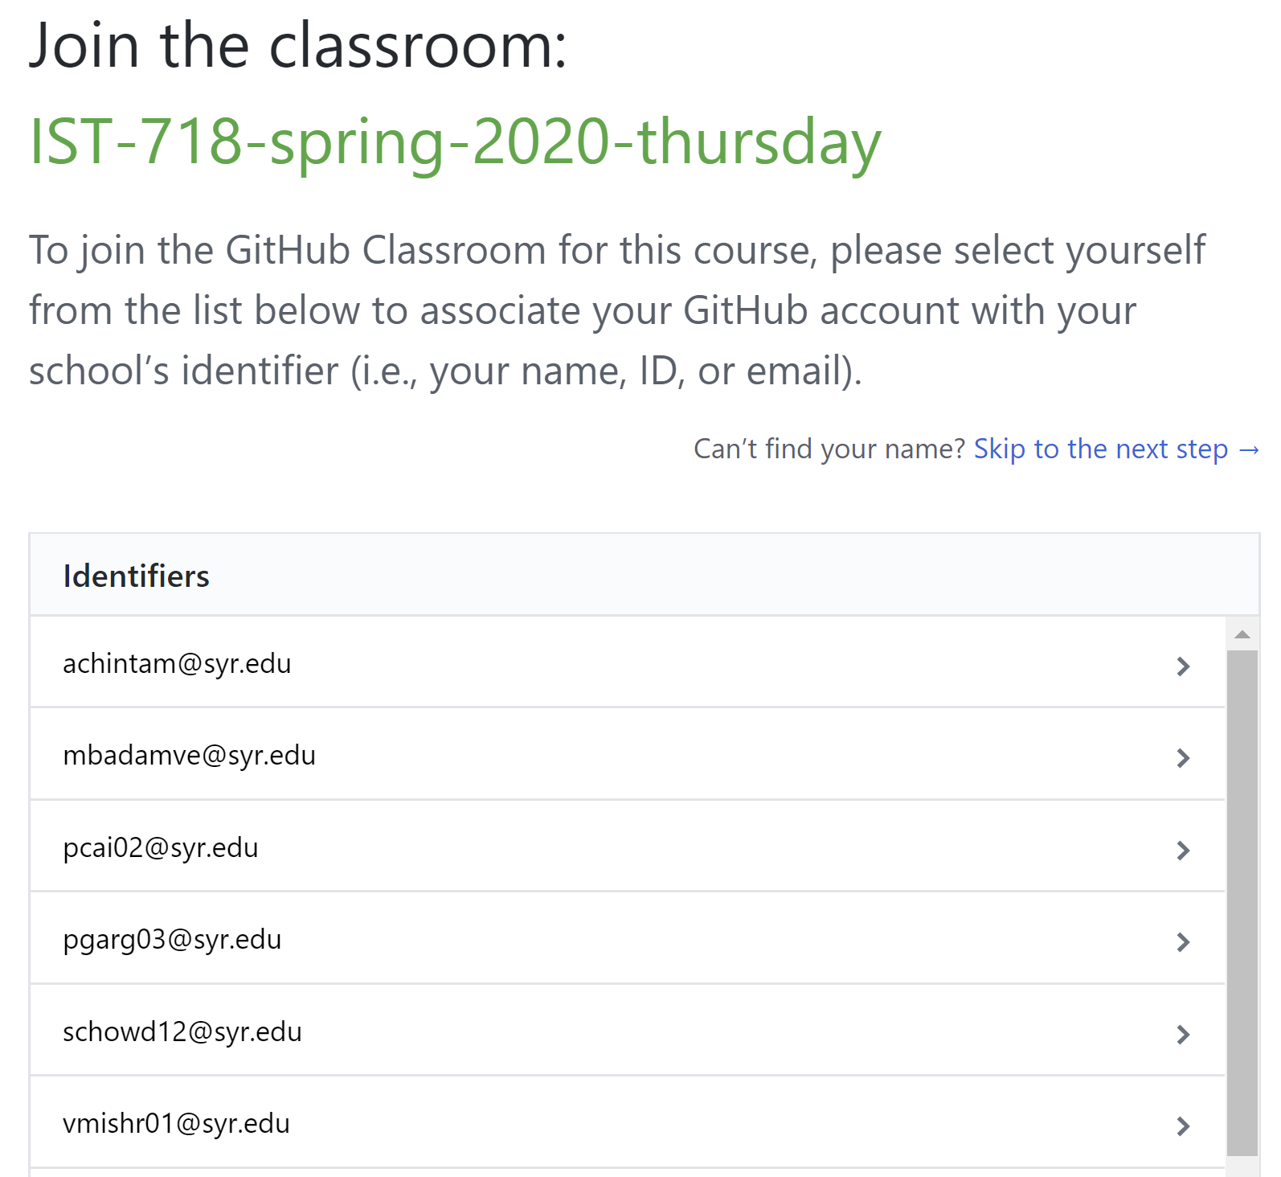
Download the student homework repo
Click the homework repo link emailed by the instructor
If you have not yet joined the github classroom, you will be directed to the page on the right to join the classroom
Select your email address from the list

Slide 12
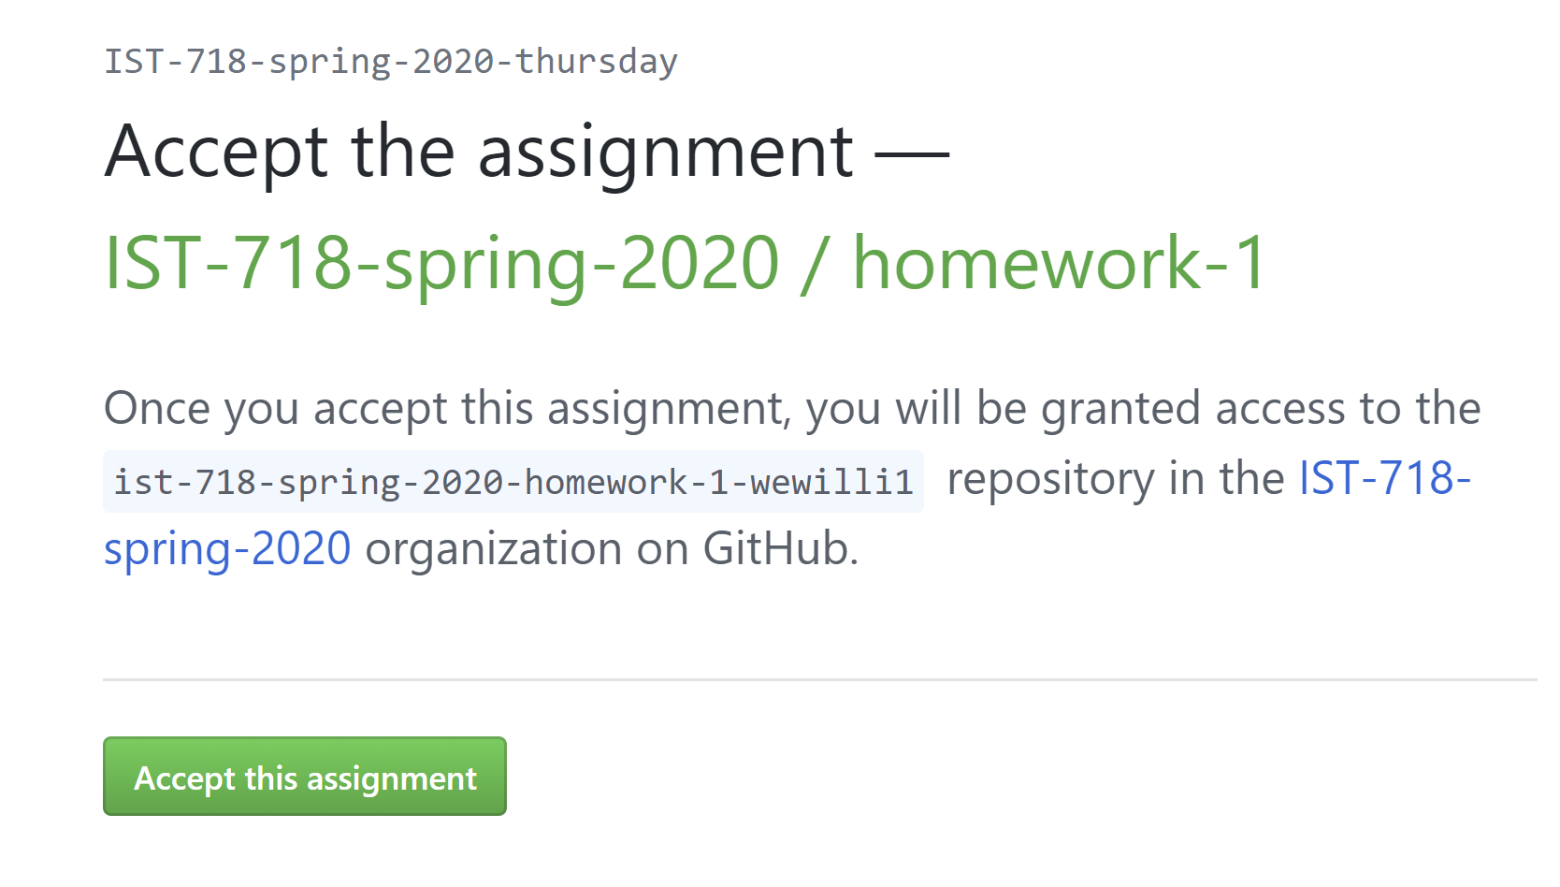
Download the student homework repo
After you select your email address on the previous slide, you will be directed to the screen on the right to accept the assignment.
Click the “Accept this assignment” button

Slide 13
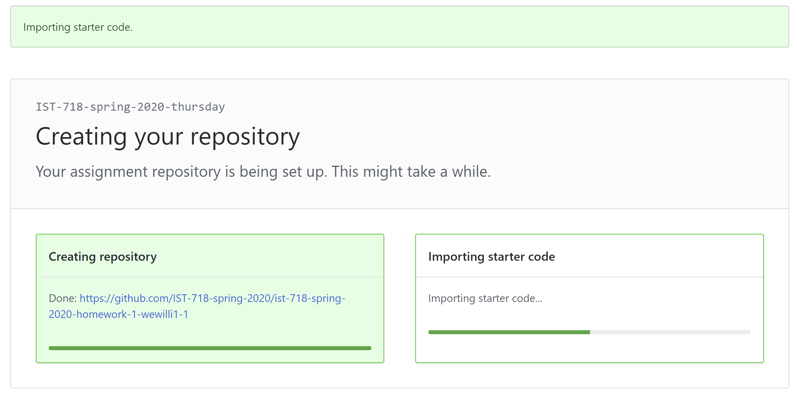
Download the student homework repo
After accepting the assignment, github will import the assignment repo into your personal github account.
The “importing starter code” box shows the import progress
It could take up to an hour or two for the starter code to finish importing. Be patient, it will finish eventually

Slide 14
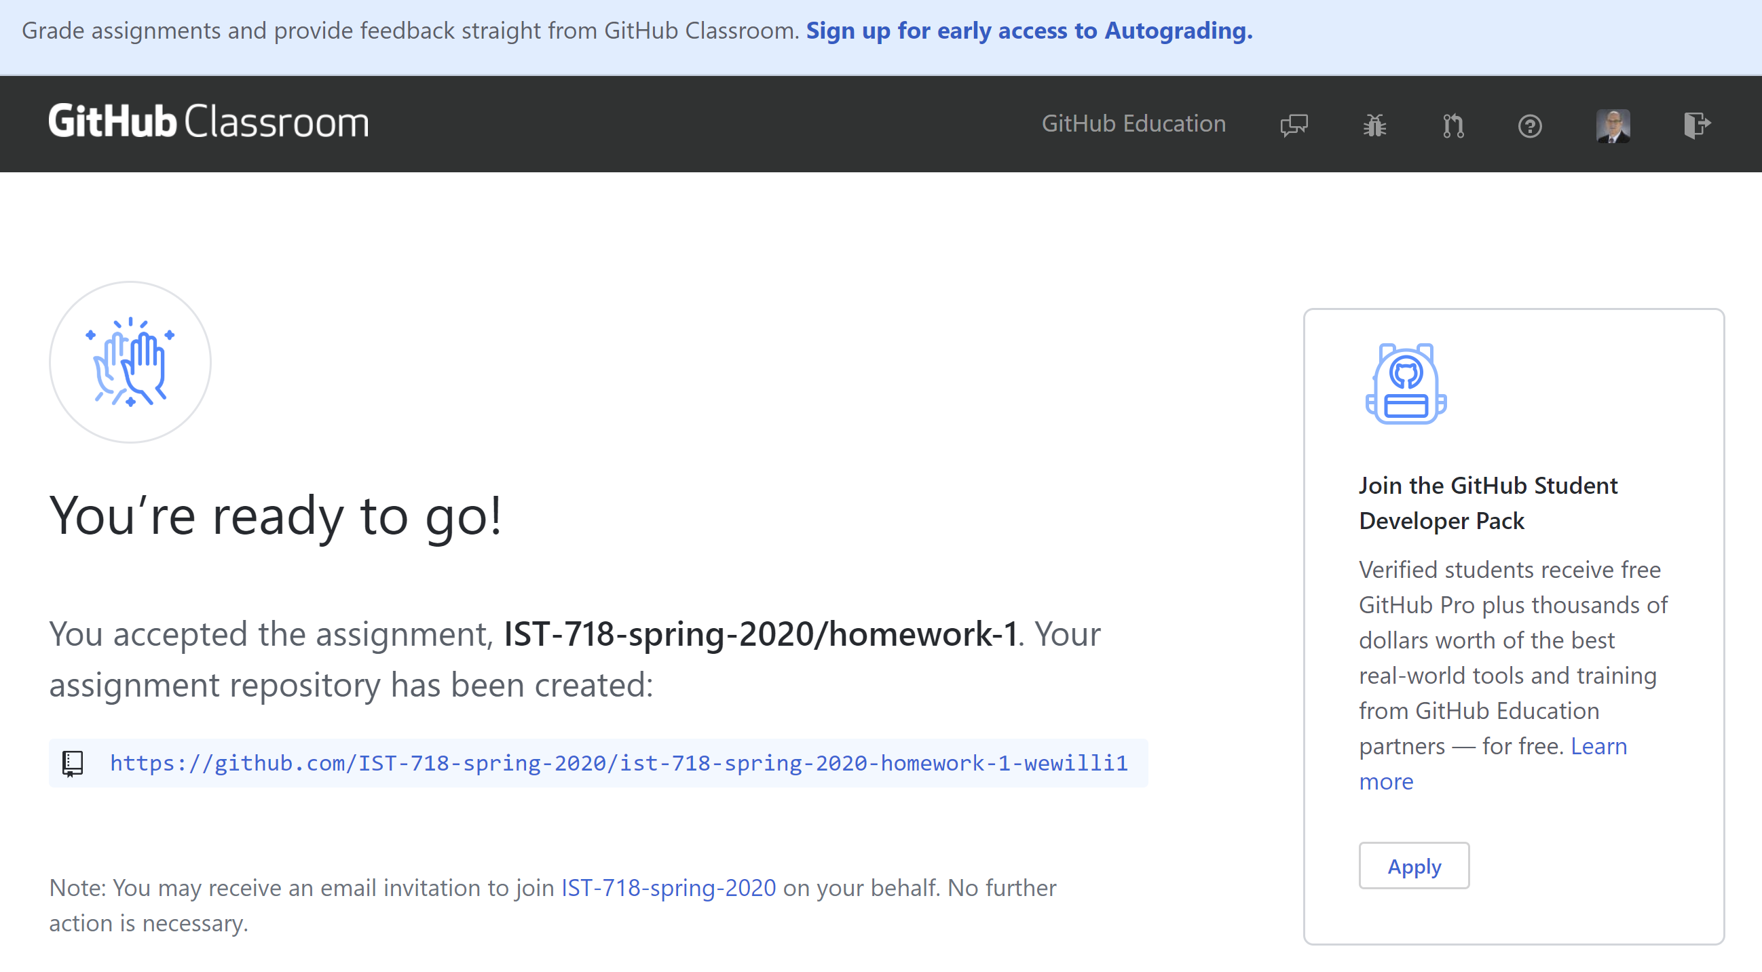
Download the student homework repo
After the assignment is finished importing, click the resulting link to navigate to the assignment.

Slide 15
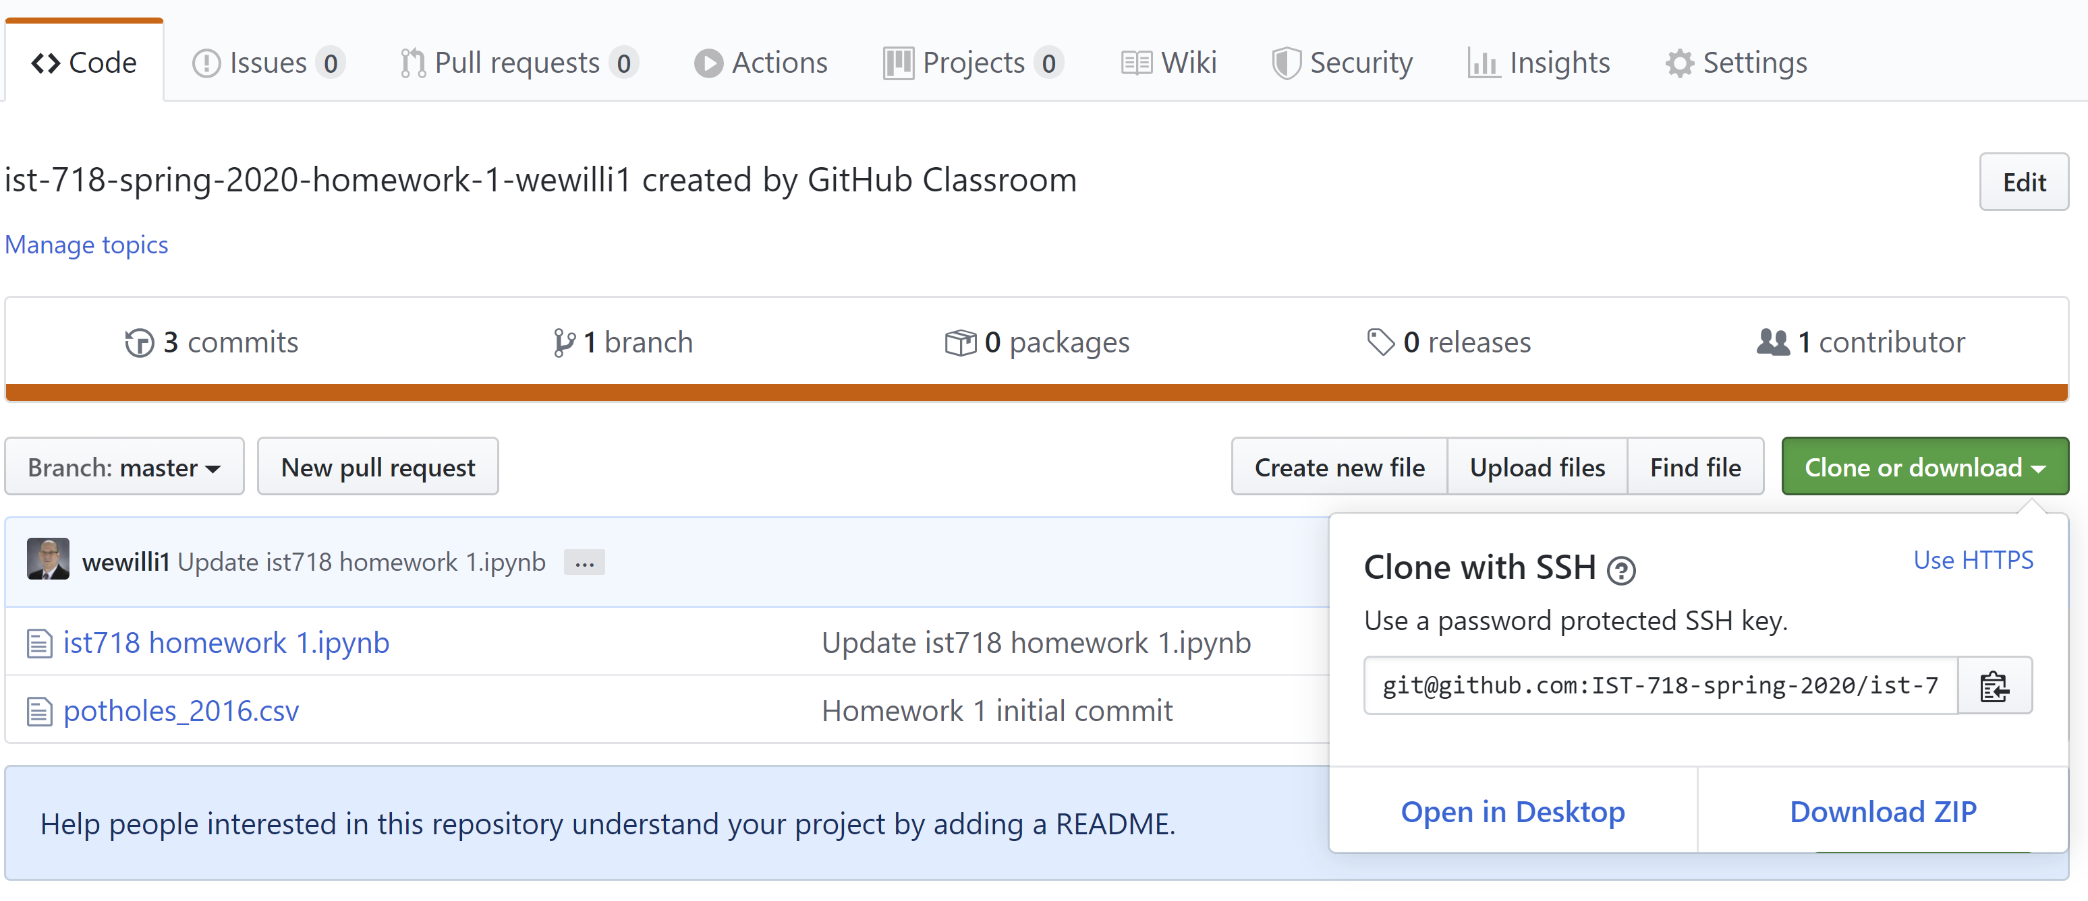
Download the student homework repo
Click the “clone or download” link
Select download zip
Save the zip file to a known location on your computer

Slide 16
Unzip the repo zip file
After you download the repo zip file, explode the zip file on your computer into a known location.
You will need to navigate to the known location you exploded the zip file with the github desktop app.

Slide 17
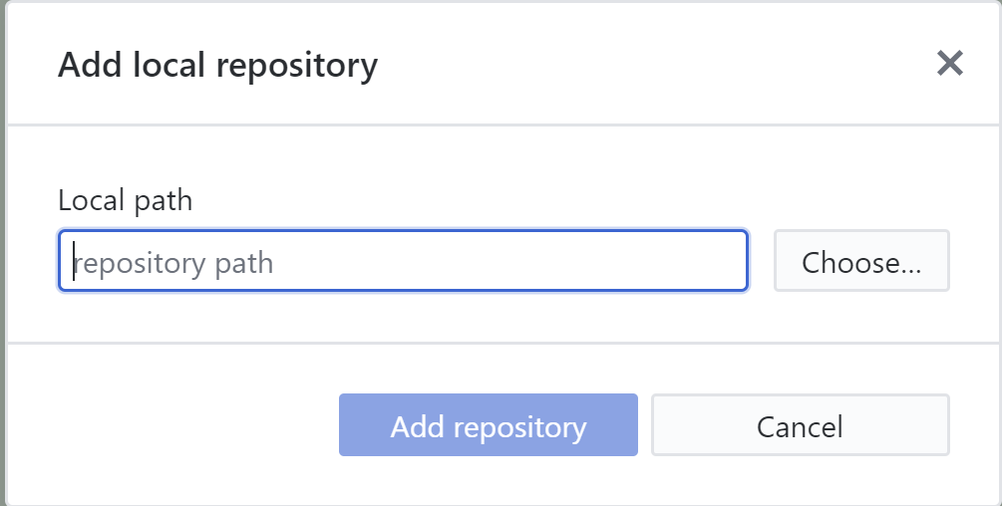
Submitting the assignment
Launch github desktop
Select the file pull down menu
Select the “Add local repository” option
Select the “choose” button in the resulting pop up window (shown at the right)

Slide 18
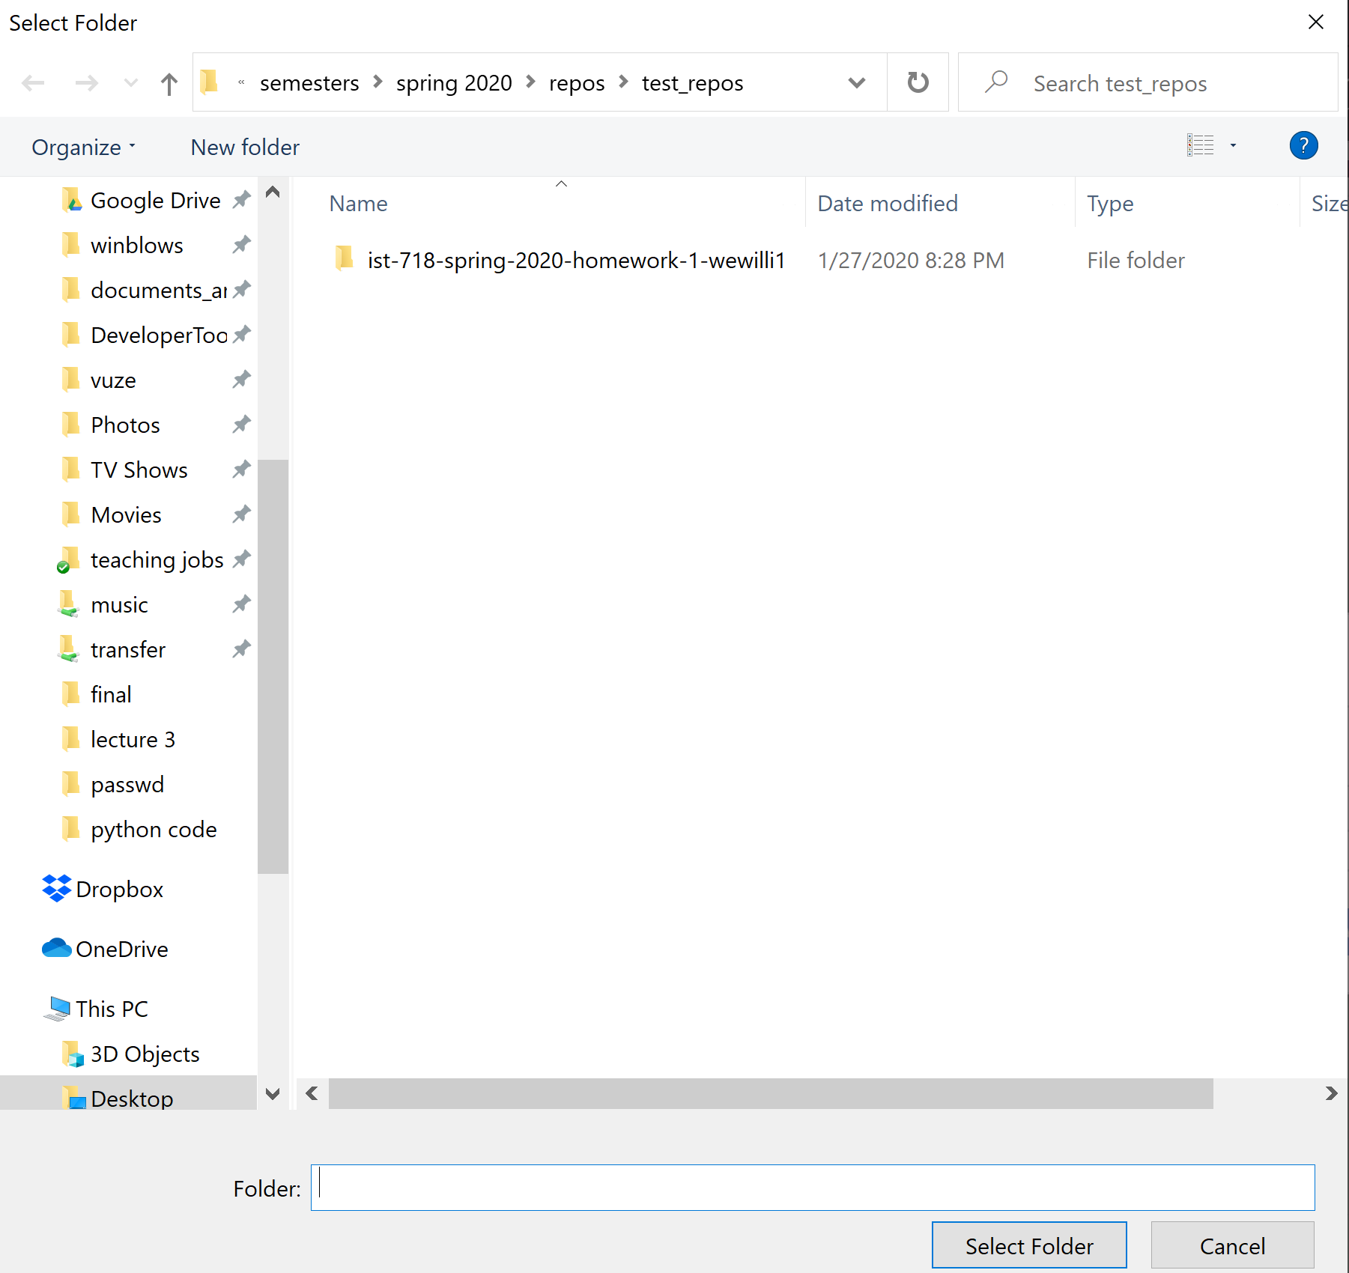
Submitting the assignment
In the resulting directory selection pop up window, navigate to the directory where you exploded the assignment repo zip file.
In the example to the right, the ist-718-spring-2020 … directory is the exploded repo – select this directory.

Slide 19
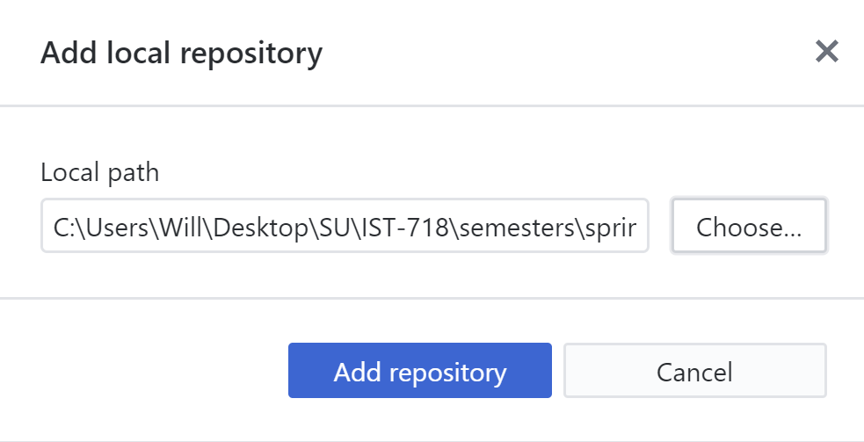
Submitting the assignment
After selecting the repo directory, click the “Add repository” button.

Slide 20
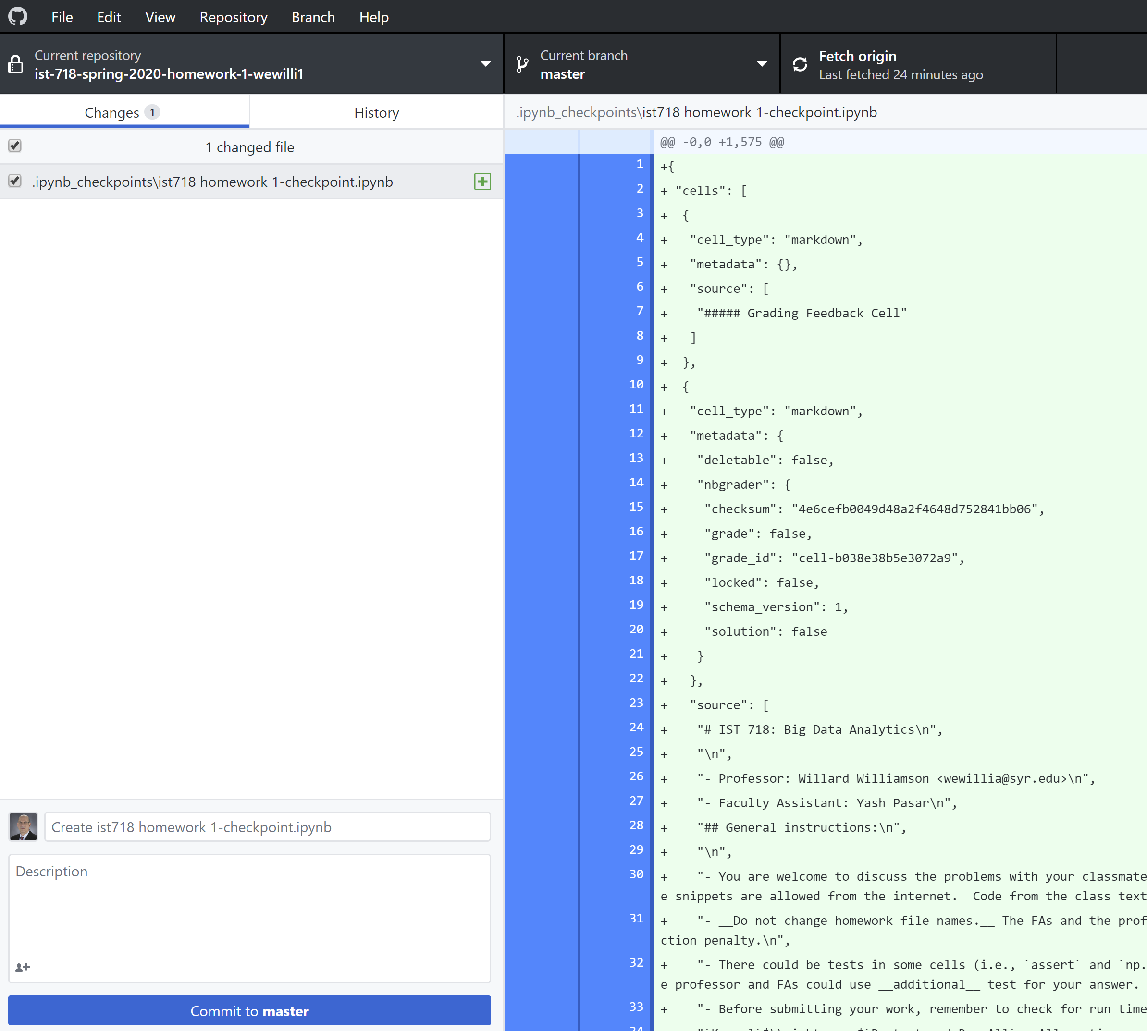
Submitting the assignment
The repo is now added to github desktop.
The panel on the left shows new and modified files – the jupyter notebook is selected
The panel on the right shows the text version of your notebook

Slide 21
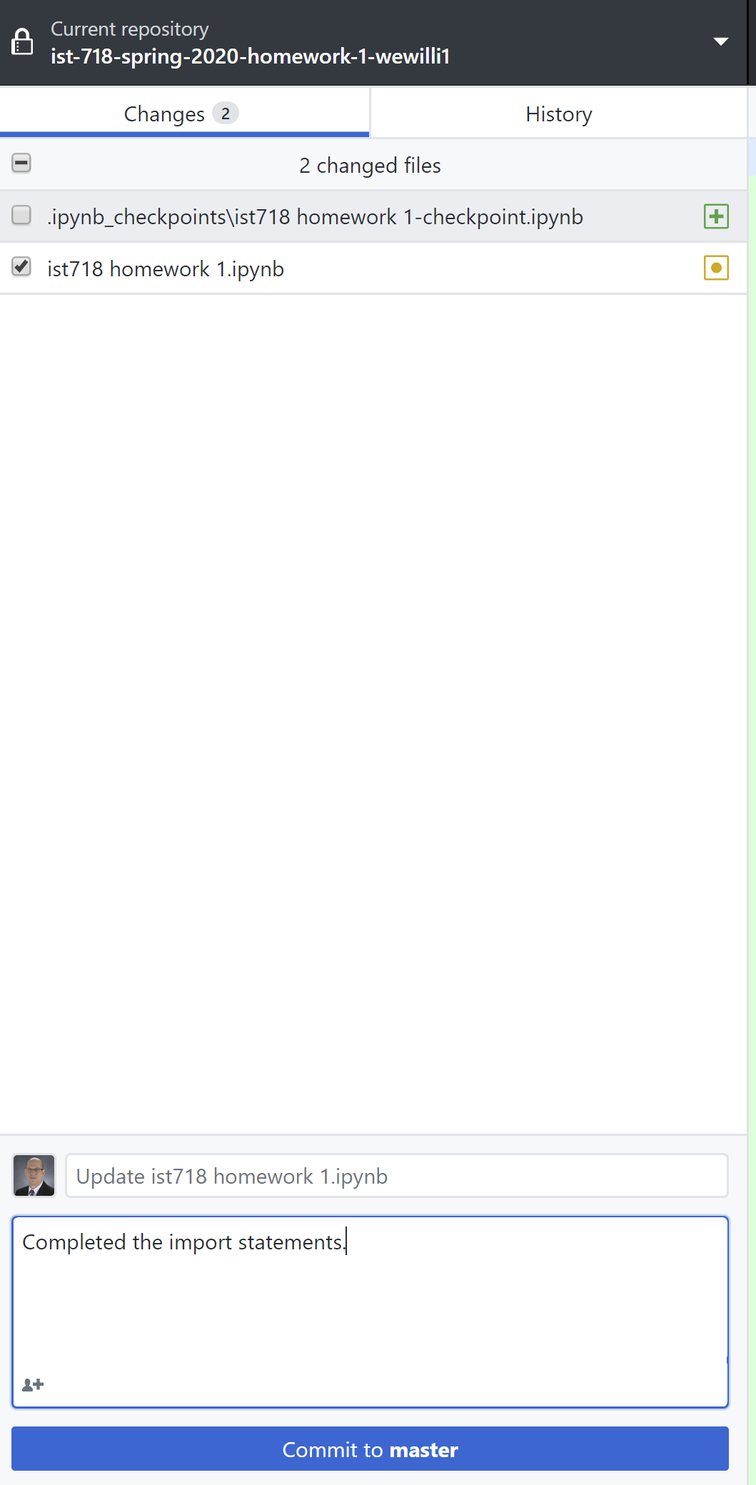
Submitting the assignment
In the example at the right, the checkpoint directory is unchecked because it is not part of the assignment submission
Make sure the ipython notebook is checked
Add a commit message in the bottom text box
Click “Commit to master” button

Slide 22
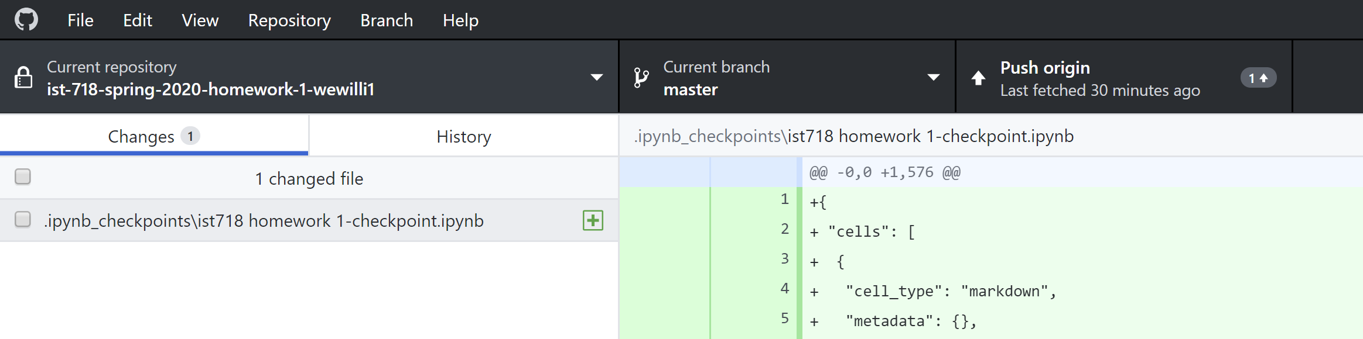
Submitting the assignment
After commiting, you assignment is in your local repo ONLY – you need to push it back to github to complete the submission
Click the “push origin” button in the upper right of the graphic above
The button will indicate success after the push is complete

Slide 23
Periodic Saving
It is highly recommended to commit and push your assignment frequently.
You can easily recover your assignment from github if your computer has a problem, is lost, or stolen.

Slide 24
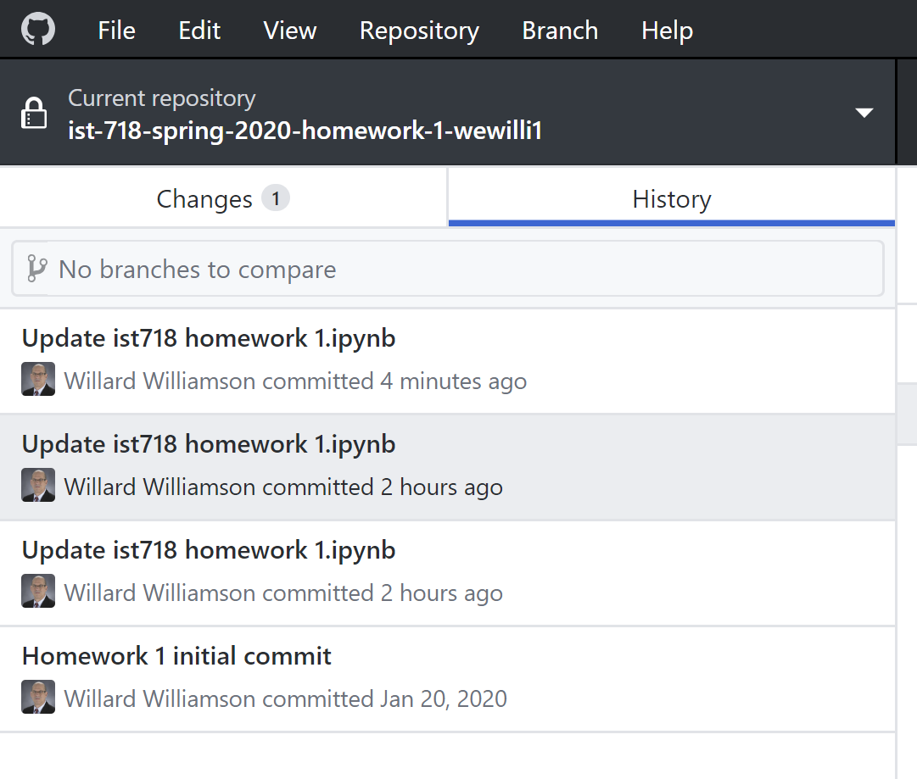
How to view commit history
The “history” tab shows you commit history
You can revert

